Slide 1



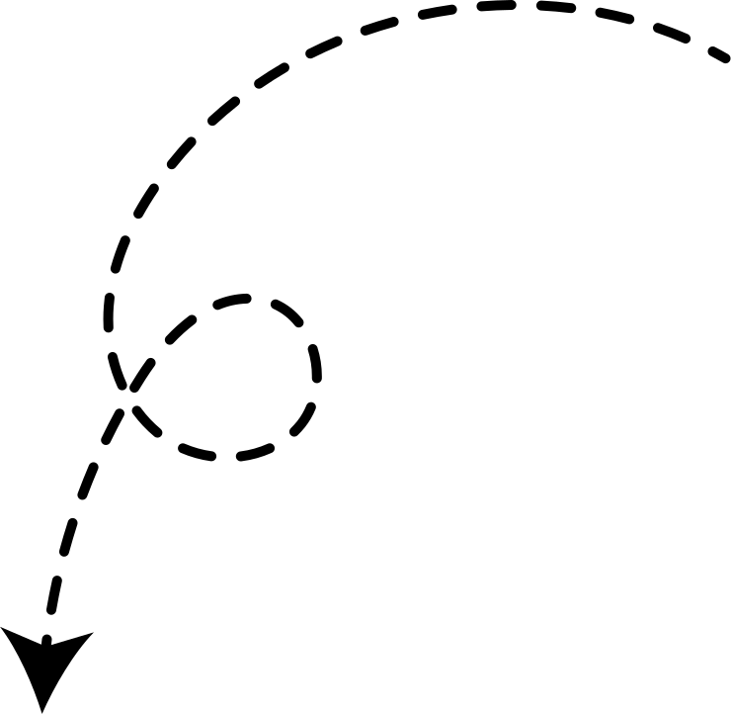
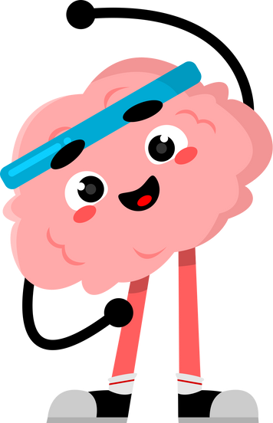


HOME OF THE
CBT
WORKBOOK
THE
CBT
Welcome to the
CBT Workbook
This PowerPoint will help guide us through the booklet as we learn and explore together.
Your teacher will lead the way, and you’ll have lots of chances to think, chat and share ideas.
Remember - there are no silly questions, and we’re all here to learn and support each other.
Let’s get started!
COGNITIVE BEHAVIOURAL TRAINING
The more you put in, the more you get out!
WORKBOOK
FOR ADULTS AND CHILDREN

Slide 2

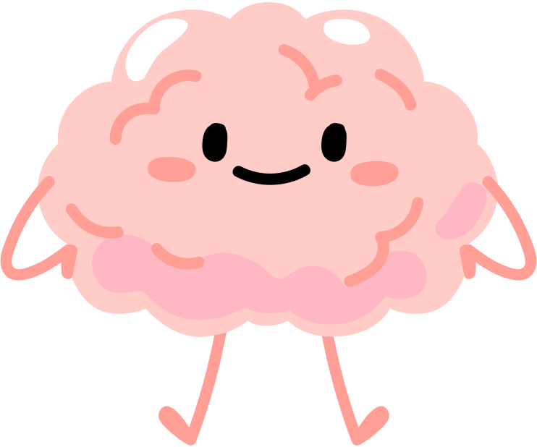
INTRODUCING CBT
What is CBT?
Cognitive Behavioral Training (CBT) is a practical approach to understanding how our thoughts, feelings, and behaviours are all connected. It helps us recognize negative thought patterns and learn ways to change them, leading to better emotional health and actions.
So, why should you learn about it?
Well, CBT can be super useful in everyday life! Whether you’re feeling nervous before an exam or stressed about a misunderstanding with a friend, CBT gives you tools to manage those tricky emotions. It helps you challenge unhelpful thoughts and replace them with more balanced ones, making it easier to stay calm and in control.
In short, learning CBT can empower you to face life with more confidence and less stress.
KEY WORDS
Cognitive: how we think and understand things
with our brain
Distortion: when something is changed or bent
out of shape, making it look different
from reality
1

Slide 3


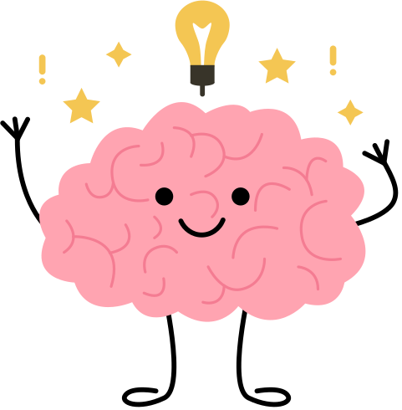





THE
COGNITIVE TRIANGLE
The Cognitive Triangle shows how our thoughts, feelings, and behaviours are all connected
Thoughts
The Three Points of the CBT Triangle are:
  Thoughts: What we think about situations, ourselves, or the future
  Feelings: How we feel based on those thoughts
(e.g., anxious, sad, happy)
  Behaviours: What we do as a result of our thoughts and feelings (e.g. avoiding, acting impulsively, or taking positive action)
Our thoughts, feelings, and behaviours are all connected. Recognizing this cycle can help break negative patterns.
In fact, by addressing just one part of the cycle, we can create positive change.
Next, we’ll explore how to challenge negative thoughts by asking, "Is this thought true?" and "Is it helpful?" Spotting distortions in our thoughts helps change both our feelings and behaviours.
Behaviour
Feelings
A Football Example!
Imagine a football player thinking, "I’m going to mess up!"
  This thought makes them feel nervous.
  Because they feel nervous, they hesitate when the ball comes their way.
  They miss the ball and think, "See? I knew I’d mess up!"
  This makes them feel even more nervous next time, leading them to play even more cautiously, reinforcing their negative thoughts.
But here’s the good news… we can break the cycle! If the player changes their thought to "I’ll try my best!", they’ll feel more confident and play better.
2
3

Slide 4


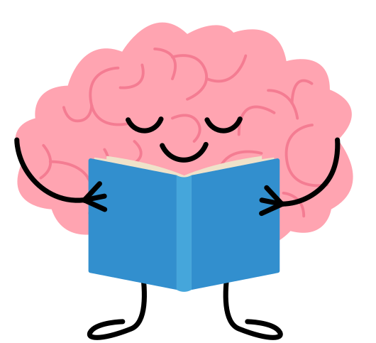

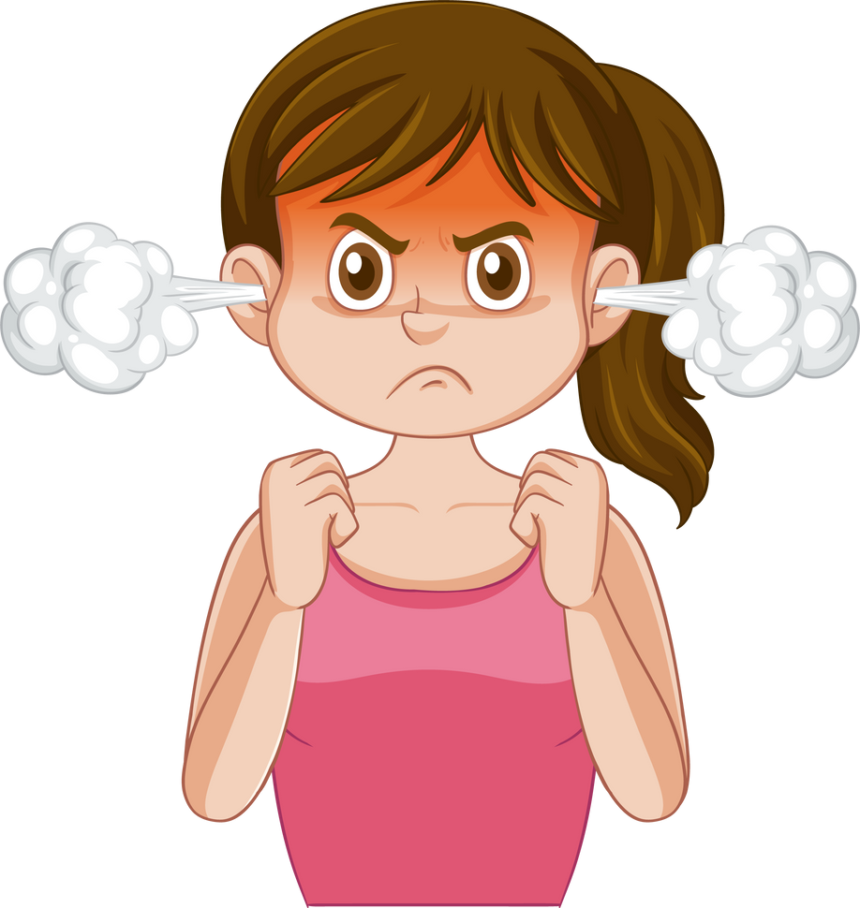




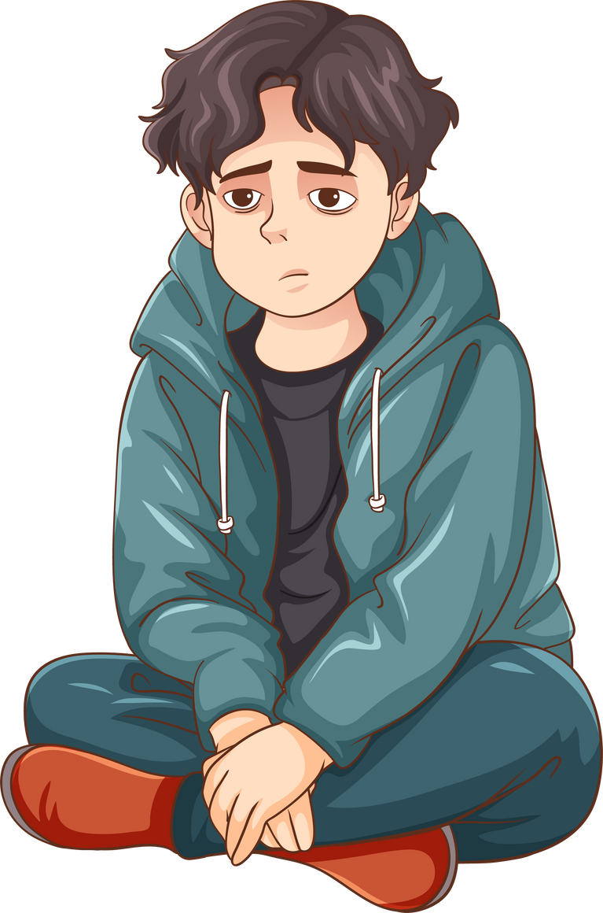

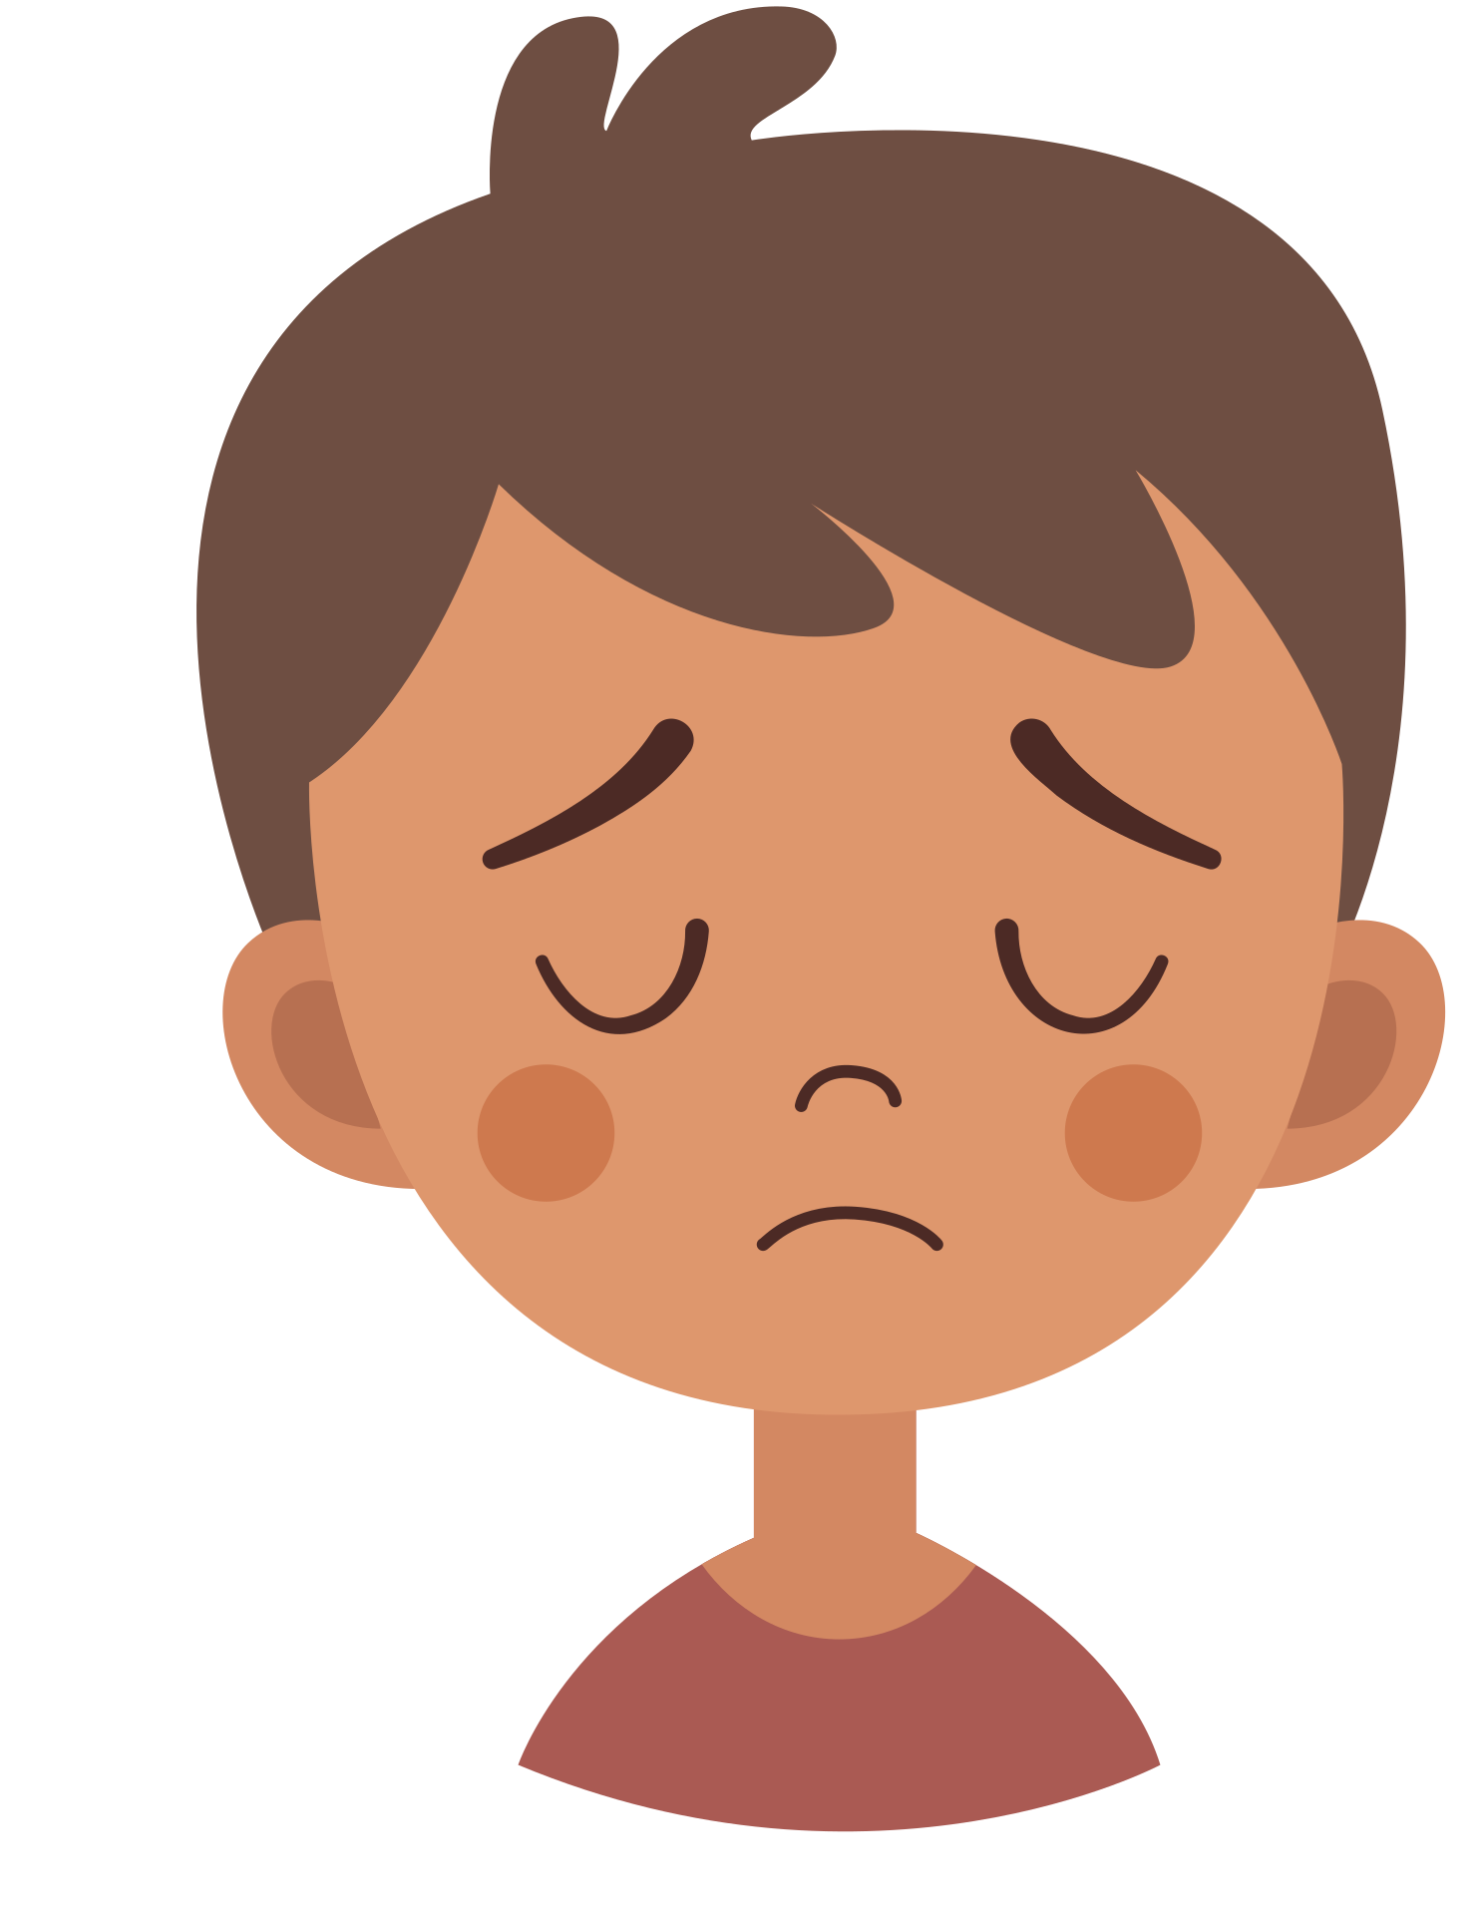


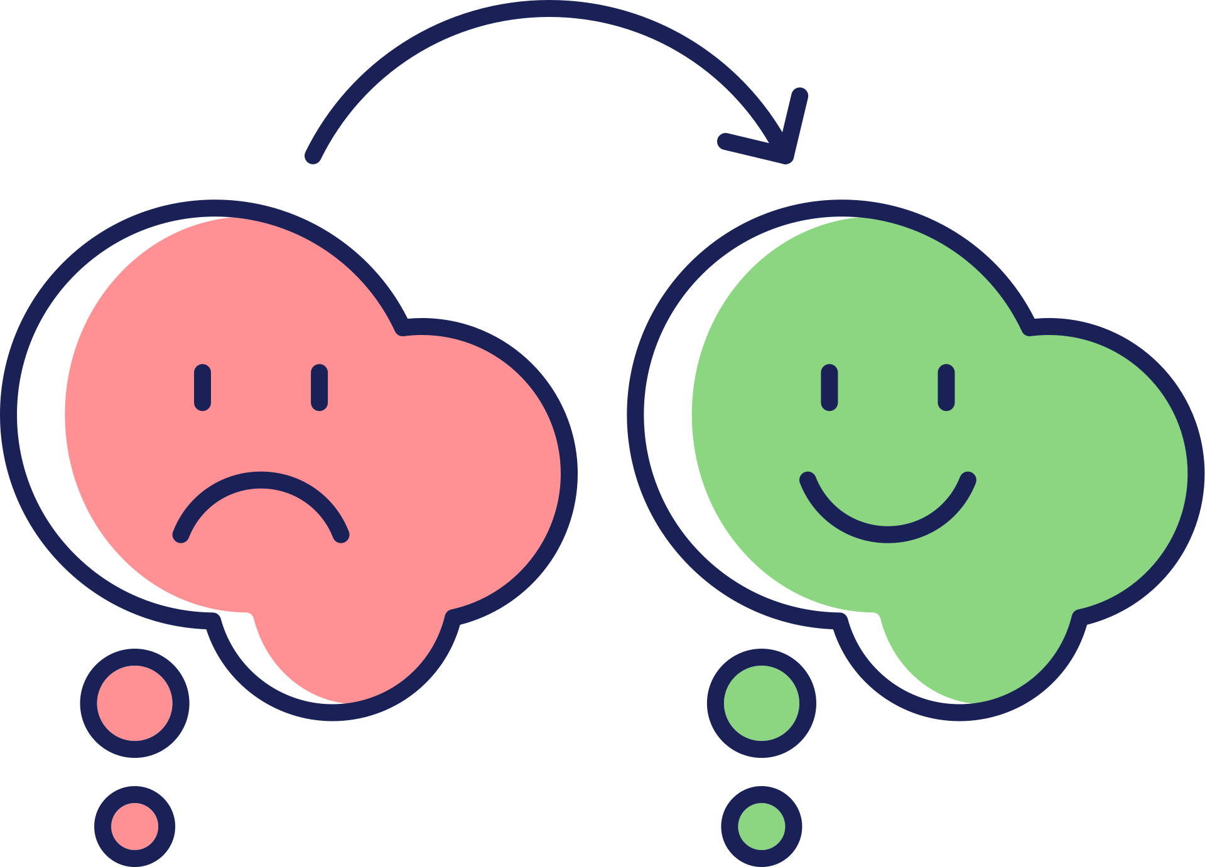
CAN YOU SPOT THE COGNITIVE DISTORTIONS IN THESE THOUGHTS?
COGNITIVE
DISTORTIONS
Remember, a lot of the distortions will overlap!
Circle the distortions in the thoughts and label them.
Changing our feelings starts with changing our thoughts.
Did you know your brain doesn’t always tell you the truth?
Look out for these distortions!
Mum always tells me off for not tidying my room!! She thinks I’m lazy and I’m not!!
She’s stupid!!
fortune
telling
mind
reading
should
statements
blame
Thinking you can see into the future.
Assuming you know what others are thinking.
Shoulda, woulda, coulda!
Stop ‘should’
statements.
Blaming others
or yourself when that’s not fair.
I’m going to do so badly at the piano recital! Everyone’s going to laugh at me! I’m an idiot!
I should have practised more!
magnification
black & white
thinking
Catastrophising
mental
filter
Turning small things into a big deal.
Most things aren’t black or white:
“I didn’t get top marks so I FAILED.”
Imagining the
worst possible thing to happen.
Dwelling on the negatives and not counting the positives.
My best friend didn’t
sit next to me on the bus.
I must have done something wrong.
Why doesn’t she like me any more?
over -generalisation
personalisation
feelings as facts
labelling
Seeing a negative event as a recurring pattern: "This always happens to me!"
You take things personally when it wasn’t meant that way.
"I feel stupid,
so that means
I must be stupid."
Instead of saying:
‘I made a mistake’ you say:
‘I’m a loser.’
always ask yourself two questions:
Is my thought true?
Is my thought helpful?
Remember! You can change the way you feel
by changing your thoughts
are these thoughts helpful? Are they true?
can you think of alternative thoughts
which are more helpful and realistic?
4
5

Slide 5



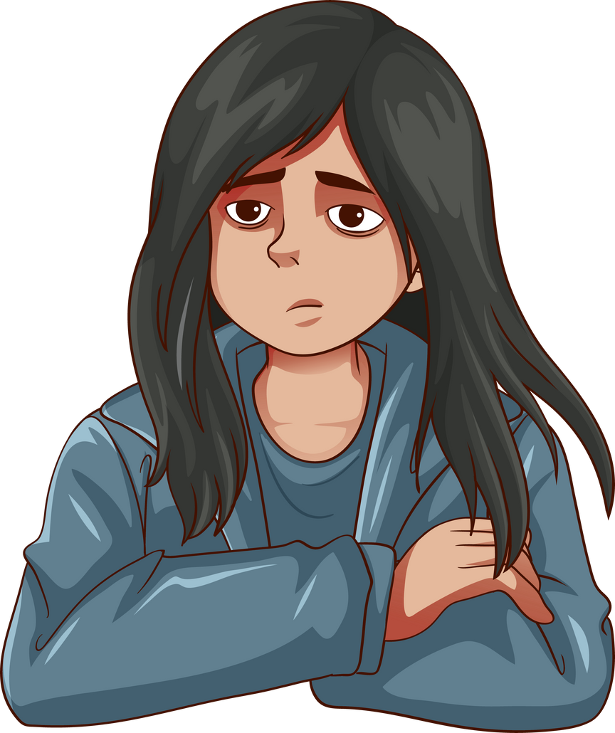
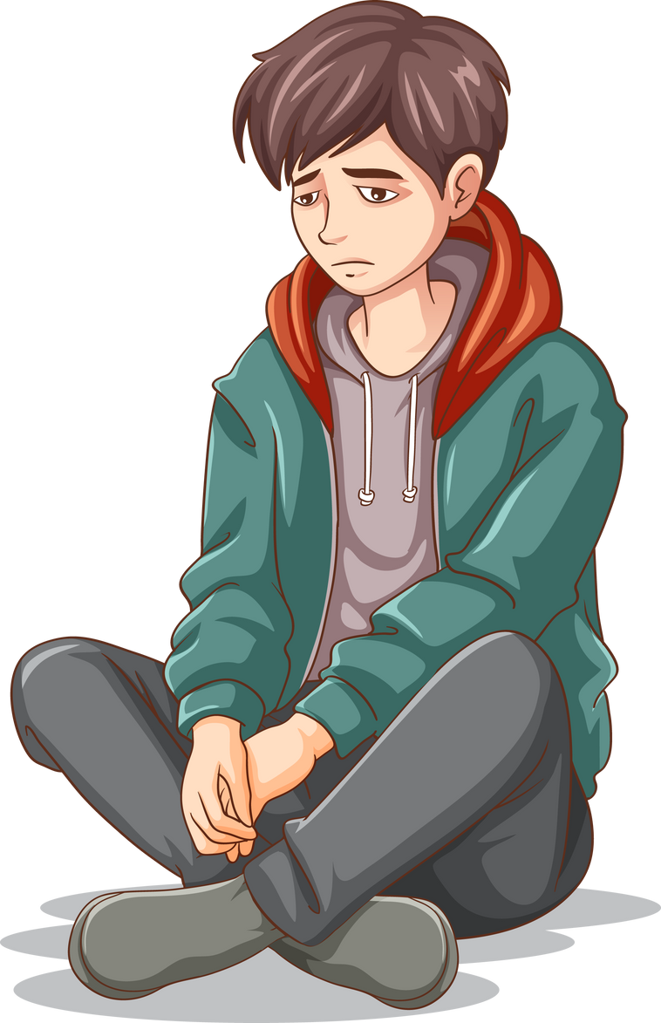


REFRAMING THOUGHTS
example of cognitive distortions
Once we’ve identified cognitive distortions, we can focus on replacing our unhelpful thought with a more helpful thought. The key with ‘reframing’ is to stay realistic and positive.
Now take a minute to look at the example opposite... The girl has spotted the distortions in her thinking - so what could her new thought be? She could think, “I’m so popular! Everybody likes me!” But is it realistic to be liked by everybody?
Here’s a better reframing thought:
Mind Reading
over-generalisation
You don’t know what other people are thinking
"No one ever wants to hang out with me. They think I’m boring. I’m a loser."
No one? Ever?
Is that true?
labelling
“Just because I haven't been asked to hang out lately doesn't mean people don't like me. Everyone has busy schedules. I can always reach out and make plans!”
self-blame
Terms like ‘loser’ draw on black & white thinking and never tell the full story. Would you use this term to describe someone else?
Don’t blame yourself
for other people’s actions
Have a look at the thoughts below. Spot the distortions then have a go at creating a new, more helpful thought.
I failed the test. I’m terrible at school. I’ll never do well in anything.
cognitive distortions
reframing thought
"I’ve got a huge pimple! I look awful! Everyone will stare at me at school."
6
7

Slide 6
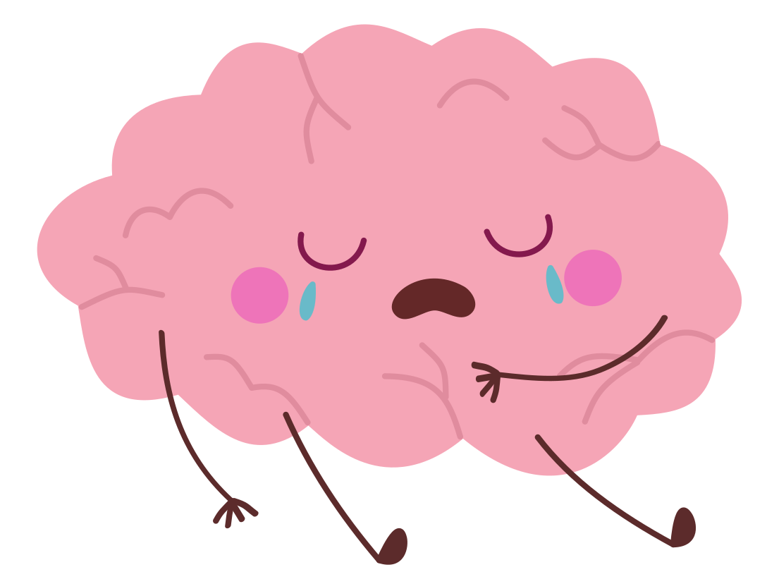



COGNITIVE DISTORTION
WORKSHEET
NOT FEELING GREAT?
FILL OUT THIS WORKSHEET TO REBOOT YOUR THOUGHTS AND FEELINGS!
Before you start, how do you feel? Rate your emotions out of 10.
I am feeling
SAD:
ANGRY:
ANXIOUS:
EMBARRASSED:
FRUSTRATED:
GUILTY:
NERVOUS:
WHAT’S YOUR THOUGHT?
COGNITIVE DISTORTIONS?
WHAT’S YOUR
MORE HELPFUL THOUGHT?
Thought 1
Thought 2
Thought 3
Finished? Do you feel a little better? Rate your emotions out of 10 again.
I am feeling
SAD:
ANGRY:
ANXIOUS:
EMBARRASSED:
FRUSTRATED:
GUILTY:
NERVOUS:
over -generalisation
personalisation
feelings
as facts
labelling
magnification
black & white
thinking
Catastrophising
mental
filter
fortune
telling
mind
reading
should
statements
blame
Turning a negative event into a pattern: “This always happens!”
You take things personally when
it wasn’t meant
that way.
“I feel like an
idiot so I must
be one.”
Instead of saying:
‘I made a mistake’ you say:
‘I’m a loser.’
Turning small things into a big deal.
Most things aren’t black or white - they’re on the greyscale.
Imagining the
worst possible thing to happen.
Dwelling on the negatives and not counting the positives.
Thinking you can predict the future.
Assuming you know what others are thinking.
Shoulda, woulda, coulda!
Stop ‘should’
statements.
Blaming others
or yourself when that’s not fair.

Slide 7


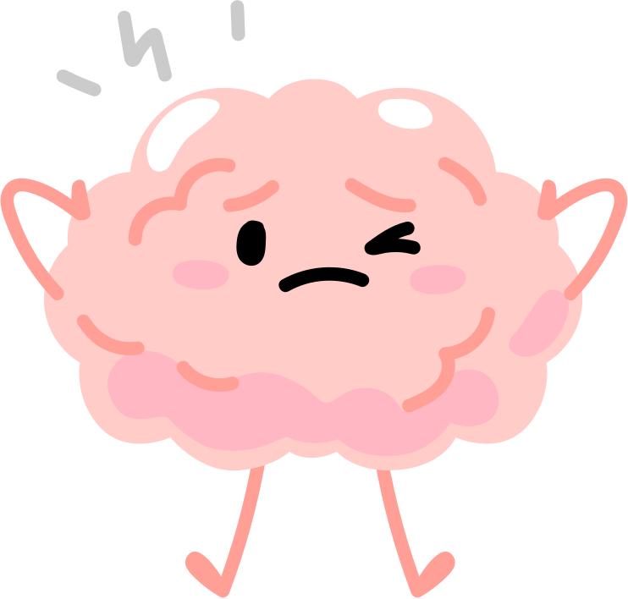

WORKSHEET SMERKSHEET
Help! My feelings are too BIG to do a worksheet!
Sometimes, emotions can be overwhelming, making it hard to focus on tasks like a worksheet. Whether you’re in a fit of rage or experiencing anxiety or a panic attack, it’s important to remember that these intense feelings won’t last forever - and that you have control over them.
Here are some quick ways to regain control and calm down. (And once you feel up to it, do a worksheet!)
box breathing
grounding
distraction
Muscle Relaxation
When you feel really angry or worried, it can help to distract your mind for a bit.
You can try things like:
  Listening to music
  Playing with friends
  Going for a walk
  Counting to ten
  Drawing
These activities help you take a break from big feelings.
Even better, moving your body, like running or jumping, can help you feel better and clear your mind.
By doing something else, you can feel calmer and see things more clearly.
  Sit or lie down comfortably
  Make tight fists with your hands. Hold for a few seconds, then let them go and relax.
  Make your arms stiff. Hold for a few seconds, then let them relax.
  Shrug your shoulders up to your ears. Hold, then let them drop and relax.
  Scrunch up your face. Hold, then let it go soft.
  Stretch your legs out. Hold, then let them relax.
Take a big breath and feel your body calm down!
  Breathe in through your nose for 4 seconds.
  Hold your breath for 4 seconds.
  Breathe out slowly through your mouth for 4 seconds.
  Hold again for 4 seconds.
Do this 3 to 5 times. It helps you feel calm and less panicky.
The 5-4-3-2-1 grounding exercise:
  5 things you can see – Look around and name five things you can see.
  4 things you can touch – Feel four different things around you.
  3 things you can hear – Listen for three sounds.
  2 things you can smell – Focus on two smells (if you can).
  1 thing you can taste – Notice any taste in your mouth.
This helps you feel more in the moment and calm again.
In
Hold
Hold
Out
Take note of what triggers negative feelings and notice what helps you feel relaxed. Music? Football? Talking to friends? Your favourite TV show? Try to incorporate things that make you happy into your everyday life.
10
11

Slide 8


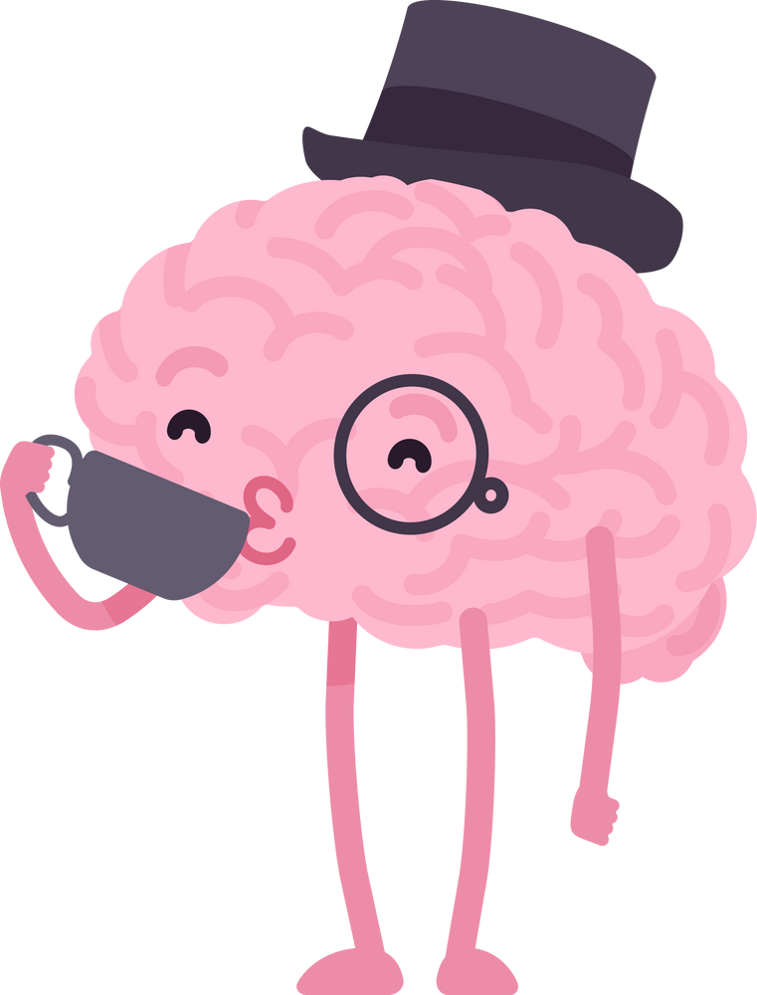
KNOW YOURSELF
Knowing yourself
is one of the most important things you can do.
It’s about understanding what makes you feel happy, what brings you peace, and what drains you or makes you upset.
Does exercise help clear your mind? Does time on your phone leave you feeling anxious? The more you know what works for you, the better you’ll be at looking after yourself and navigating life’s challenges.
Take a moment to think about which activities have a postive or negative effect on your mood. Think carefully—staying up late might feel fun at the time, but how do you feel the next day? Similarly, junk food can be a treat, but does too much leave you feeling sluggish? Pay attention to how your choices impact your energy and emotions. Put a tick or a cross next to the activities you feel are good / bad for you.
FINAL NOTE
Well done for finishing this workbook!
Remember, feelings aren’t good or bad - they’re just helpful or unhelpful. It’s okay to feel angry, sad, or worried, but if those feelings make things harder, that’s when you can change them.
As you keep going, ask yourself if your thoughts are really true. Always be on the look-out for cognitive distortions! Be kind to yourself, just like you would be to a friend.
Negative thoughts can come back - but that doesn’t mean CBT isn’t working! It just means it’s time to try a worksheet again. The more you practice, the easier it gets! You don’t need this workbook every time - just a pen and paper to keep practicing.
And remember - if you ever feel really sad, angry, or worried, it’s really important to talk to someone you trust. There are people who care and are ready to listen.
You’ve got this!
Watching TV
Reading a book
Going to bed late
Hanging with a friend
Listening to music
Playing a sport
Helping someone else
Writing a journal
Homework
Dancing and singing
Scrolling / checking messages
Eating junk food
Going for a walk
Being by myself
Taking a bath / shower
Having a tidy bedroom
Getting up early
Gaming
Playing an instrument
Sleeping
ME
12
13

Slide 9




this workbook is based on the work of Dr aaron t. beck, father of cbt, and
Dr David Burns, author of ‘the feeling good handbook’
To print worksheets and
download resources visit:
www.cbt-workbook.org
YOU GOT
THIS!
need help now?
Reach out to an adult you trust or call one of the many uk organisations out there to support you 24/7.
Free, confidential, 24/7 text support service for anyone in the UK who is struggling
Free, confidential support and advice, 24 hours a day on 0800 1111
Free, confidential, 24/7 helpline for whatever you’re going through on 116 123
If someone’s life is in immediate danger, always call 999.

